Slide 1


TheLook
Date
Mar 14, 2025
Inventory Management Analysis
by
Batch
Assignment
Linkedin
Link
Ahmad Rizki
RevoU FSDA batch FEB25
Advance
SQL
www.linkedin.com/in/arizabdulhanan
Tableau Link

Slide 2
Business Overview & Disclaimer
Company Overview
TheLook is a fictious eCommerce clothing site developed by the Looker team.

Slide 3
Business Overview & Disclaimer
Disclaimer
This analysis is based on a public dataset from Kaggle.
TheLook is a fictional company created for analytical purposes.
Any insights or recommendations are based on this dataset and do not necessarily apply to real e-commerce operations.

Slide 4
Business Overview & Disclaimer
Dataset Overview
Key Tables Used : order_items (detailed item-level orders) products (product details) users (user details) orders (information about each order) inventory_items (inventory & cost) events ( distribution_centers () | Relevant Fields : order_items.id, products.id, products.cost, etc. users.id, users.first_name, etc. orders.order_id, orders.status, etc. inventory_items.id, inventory_items.cost, etc. events.id, events.city, etc. distribution_centers.id, distribution_centers.name, etc.

Slide 5
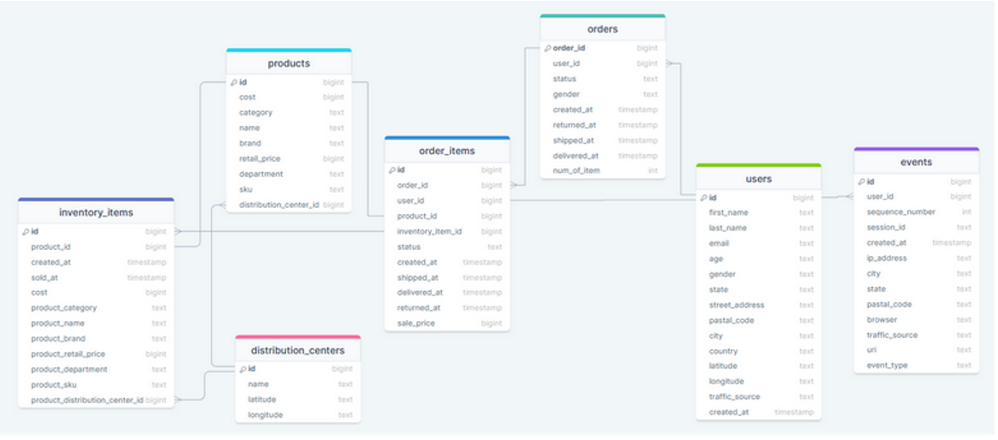
Business Overview & Disclaimer
ERD

Slide 6
Business Overview & Disclaimer
Project Goal
Identify top-performing product categories.
Analyze factors driving revenue (units sold vs customer count).
Evaluate pricing strategies and their impact on sales.
Investigate user behaviour to guide marketing and operational decisions.

Slide 7
Methodology
Approach Taken
Data extraction and transformation using SQL (BigQuery).
Breakdown of analysis around product performance, user demographics, and sales trends.
Tools :
Google BigQuery - for running SQL queries and analyzing structured datasets
Optional : Visualization in Tableau
Key SQL Queries
For each analysis, include :
Query Explanation
Formatted SQL Query
Screenshot of Query Output

Slide 8
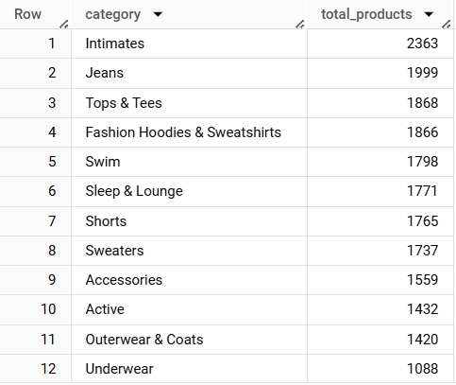
Intimates Category Leads in Product Diversity, Underwear the Lowest
Query
select
category
, count(distinct id) total_products
from fsda-sql-01.TheLook_Ecommerce.products
group by 1
order by 2 desc;

Slide 9
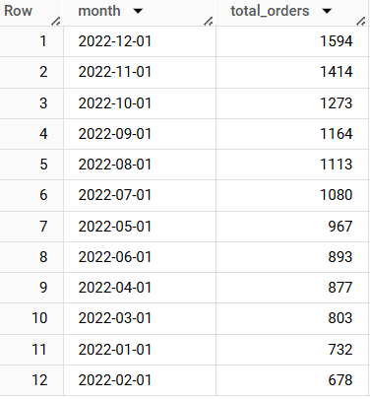
December 2022 Sees Peak in Completed Orders, February the Lowest
Query
select
date_trunc(date(delivered_at), month) month
, count(distinct order_id) total_orders
from fsda-sql-01.TheLook_Ecommerce.orders
where status = 'Complete'
and extract(year from date(delivered_at)) = 2022
group by 1
order by 2 desc;

Slide 10
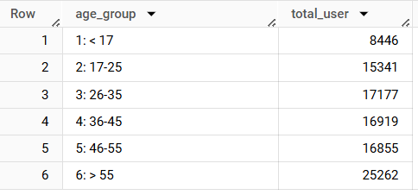
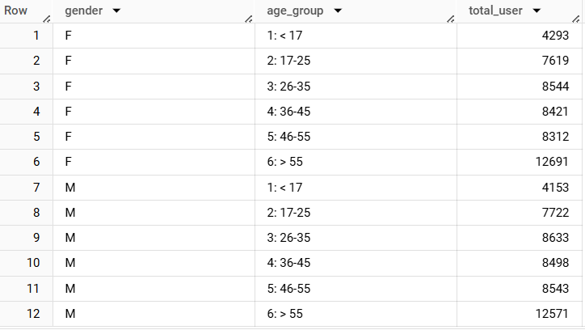
Majority of Users Aged 55+, While Under-17 Group Least Represented; Gender Split Remains Balanced
Query
select
case
when age < 17 then "1: < 17"
when age <= 25 then "2: 17-25"
when age <= 35 then "3: 26-35"
when age <= 45 then "4: 36-45"
when age <= 55 then "5: 46-55"
when age > 55 then "6: > 55"
else null end as age_group
, count(distinct id) total_user
from fsda-sql-01.TheLook_Ecommerce.users
group by 1
order by 1;
Query
select
gender
, case
when age < 17 then "1: < 17"
when age <= 25 then "2: 17-25"
when age <= 35 then "3: 26-35"
when age <= 45 then "4: 36-45"
when age <= 55 then "5: 46-55"
when age > 55 then "6: > 55"
else null end as age_group
, count (distinct id) total_user
from fsda-sql-01.TheLook_Ecommerce.users
group by 1, 2
order by 1, 2;

Slide 11
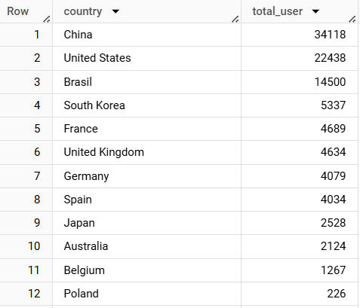
China Tops User Demographics, While Poland Has the Fewest Users
Query
select
country
, count(distinct id) total_user
from fsda-sql-01.TheLook_Ecommerce.users
group by 1
order by 2 desc;

Slide 12
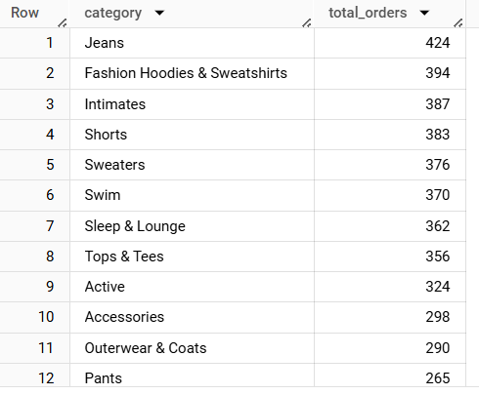
Jeans Lead, Pants Lag in Completed Orders for Q4 2022
Query
select
products.category
, count(distinct order_items.order_id) total_orders
from fsda-sql-01.TheLook_Ecommerce.order_items
join fsda-sql-01.TheLook_Ecommerce.products
on products.id = order_items.product_id
where order_items.status = 'Complete'
and extract(year from date(delivered_at)) = 2022
and extract(quarter from date(delivered_at)) = 4
group by 1
order by 2 desc;

Slide 13
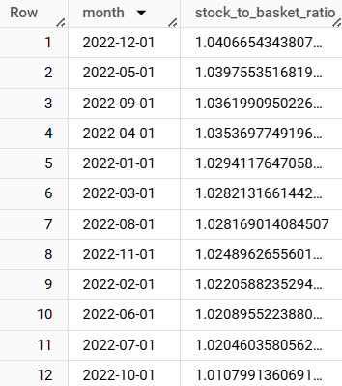
December 2022 Shows Highest Stock-to-Basket Ratio for Tops & Tees, Indicating Possible Overstocking
Query
select
date_trunc(date(order_items.created_at), month) month
, (count(distinct order_items.id) / count(distinct order_items.order_id)) stock_to_basket_ratio
from fsda-sql-01.TheLook_Ecommerce.order_items order_items
join fsda-sql-01.TheLook_Ecommerce.products products
on order_items.product_id = products.id
where products.category = 'Tops & Tees'
and extract(year from date(order_items.created_at)) = 2022
group by 1
order by 2 desc;
Key points :
December 2022 has the highest ratio which might indicate overstocking.
October 2022 has the lowest ratio might suggest understocking or high demand.

Slide 14
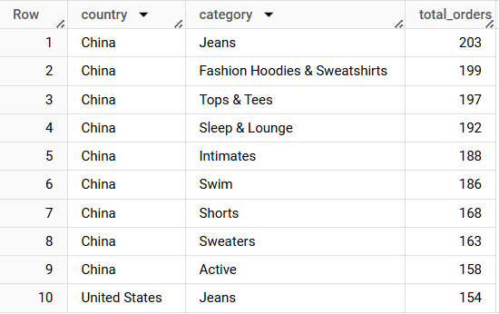
China Dominates Completed Orders Across Top 10 Categories in 2021
Query
select
country
, products.category
, count(distinct order_id) total_orders
from fsda-sql-01.TheLook_Ecommerce.order_items order_items
join fsda-sql-01.TheLook_Ecommerce.products products
on order_items.product_id = products.id
join fsda-sql-01.TheLook_Ecommerce.users users
on order_items.user_id = users.id
where status = 'Complete'
and extract(year from date(order_items.delivered_at)) = 2021
group by 1, 2
order by 3 desc
limit 10;

Slide 15
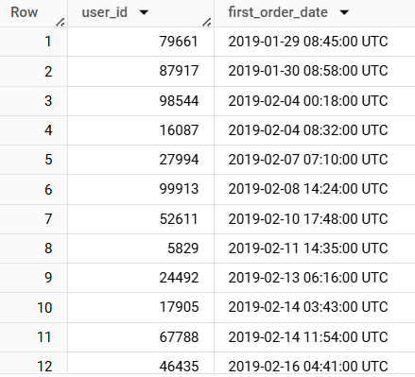
First User Order Traced Back to January 29, 2019
Query
select
user_id
, min(created_at) first_order_date
from fsda-sql-01.TheLook_Ecommerce.orders
where status = 'Complete'
group by 1
order by 2;

Slide 16
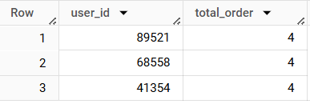
Top 3 Loyal Customers Identified, Each with 4 Completed Orders
Query
select
user_id
, count(distinct order_id) total_order
from fsda-sql-01.TheLook_Ecommerce.orders
where status = 'Complete'
group by 1
order by 2 desc
limit 3;

Slide 17
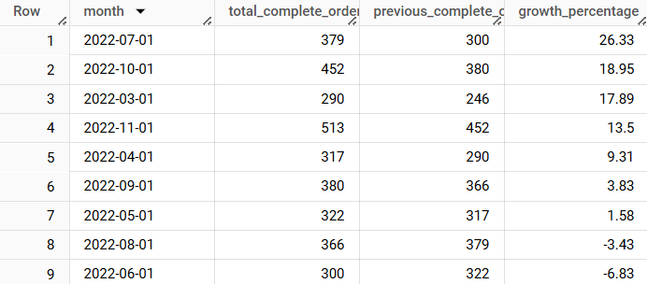
July 2022 Marks Peak Growth in China’s Completed Orders at 26.33%
Query
with CurrentTable as (
select
date(date_trunc(orders.created_at, month)) month
, count(distinct orders.order_id) total_complete_order
from fsda-sql-01.TheLook_Ecommerce.orders orders
join fsda-sql-01.TheLook_Ecommerce.users users
on orders.user_id = users.id
where orders.status = 'Complete'
and extract(year from date(orders.created_at)) = 2022
and users.country = 'China'
group by 1
),
PrevTable as (
select
*
, lag(total_complete_order) over(order by month) previous_complete_order
from CurrentTable
order by month
)
select
*
, round(((total_complete_order - previous_complete_order) /
previous_complete_order) * 100, 2) growth_percentage
from PrevTable
where month between '2022-03-01' and '2022-11-01'
order by 4 desc;
Key points :
July 2022 has the highest growth in completed orders with 26.33%.
Meanwhile, June 2022 has the lowest growth rate, even negative with -6.83%.

Slide 18
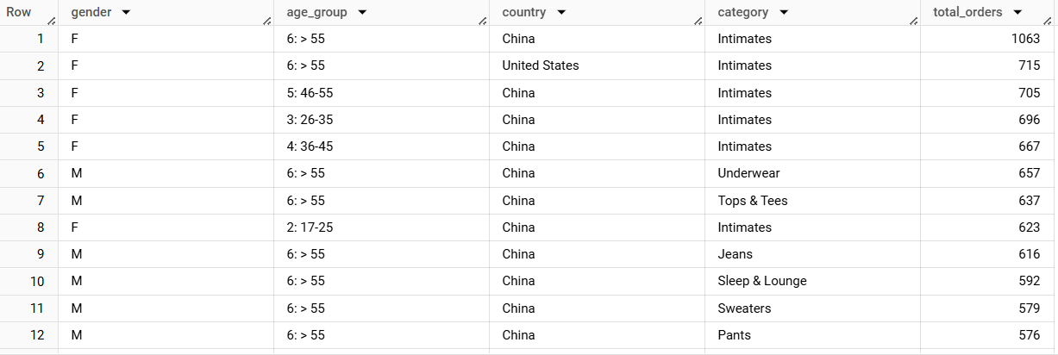
China Leads in Intimates Sales Category
Query
select
gender
, case
when age < 17 then "1: < 17"
when age <= 25 then "2: 17-25"
when age <= 35 then "3: 26-35"
when age <= 45 then "4: 36-45"
when age <= 55 then "5: 46-55"
when age > 55 then "6: > 55"
else null end as age_group
, country
, category
, count(distinct order_id) total_orders
from fsda-sql-01.TheLook_Ecommerce.order_items order_items
join fsda-sql-01.TheLook_Ecommerce.users users
on order_items.user_id = users.id
join fsda-sql-01.TheLook_Ecommerce.products products
on order_items.product_id = products.id
group by 1, 2, 3, 4
order by 5 desc;

Slide 19
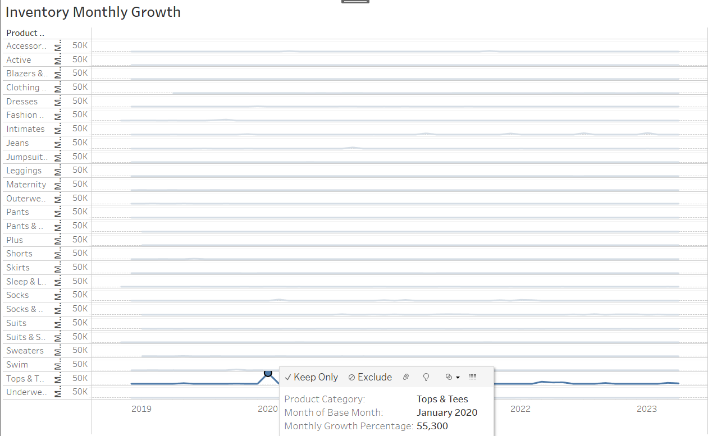
January 2020 Sees 55,300% Inventory Surge in Tops and Tees Category
Query
with BaseTable as (
SELECT
date_trunc(date(created_at), month) base_month
, product_category
, COUNT(id) AS total_inventory
FROM `fsda-sql-01.TheLook_Ecommerce.inventory_items`
GROUP BY 1, 2
)
select
product_category
, base_month
, LAG(total_inventory) over (order by base_month) total_inventory_prev
, total_inventory
, round((((total_inventory - LAG(total_inventory) over (order by base_month))
/ LAG(total_inventory) over (order by base_month)) * 100), 2) as monthly_growth_percentage
from BaseTable
group by 1, 2, 4
order by 1, 2 desc;
Key points :
From the graph, it can be seen that there was anomalous growth data on Top and Tees product category in January 2020, recording a monthly inventory increase of 55,300% from the previous month.
Source : ‘Tableau Link’

Slide 20
Recommendations
Expand the Underwear category to compete with Intimates, but continue focusing on Jeans, which are performing well.
Be more strategic with inventory management don’t overstock during peak months like December, and be ready for increased demand in months like October.
Focus marketing efforts on older customers and your biggest market, China, while considering ways to boost your Polish market.
Reward your loyal customers and look to replicate the success of months like July 2022.
Address any inventory anomalies and use the learnings to improve your stock management going forward.Introduce subscription models, loyalty programs, or bulk-buy discounts; Offer bundle deals or slightly lower prices to improve value perception and purchase frequency.

Slide 21
Date
Mar 14, 2025
Thank You
For Your Attention…
by
Batch
Assignment
Linkedin
Link
Ahmad Rizki
RevoU FSDA batch FEB25
Advance
SQL
www.linkedin.com/in/arizabdulhanan
Tableau Link

